Slide 1




Data Analysis
with Python
presentation
By Gideon Simiyu Wafula
(stay tuned 👍)
Notes:
Alright, let’s get started!
---
Welcome to our Data Analysis with Python tutorial.
My name is Santiago, and I'm an instructor at RMOTR.com, an online Data Science academy.
This tutorial is the result of a joint effort by RMOTR and freecodecamp and it's totally free. It includes Slides, Jupyter Notebooks and coding exercises.

Slide 2

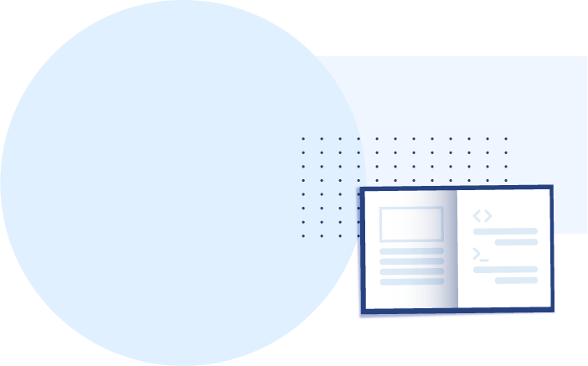
About this tutorial
What is Data Analysis
Real example Data Analysis with Python
How to use Jupyter Notebooks
Intro to NumPy (exercises included)
Intro to Pandas (exercises included)
Data Cleaning
Reading Data SQL, CSVs, APIs, etc
Python in Under 10 Minutes
Notes:
Let’s quickly review the contents of this tutorial. In the description of this video, we’ve included direct links to each section, so you can jump between them.
This is the first section, and we’re going to discuss what is Data Analysis. We’ll also talk about Data Analysis *with Python* and why programming tools like Python, SQL and Pandas are important.
In the following section, we’ll show you a real example of Data Analysis using Python, so you can see the power of it. We’ll not “explain” the tools in detail, it’s just a quick demonstration for you to understand what this tutorial is about. The following sections will be the ones explaining each tool in detail.
There are two more sections that I want to specially point out. The first one is Section no 3, “Jupyter tutorial”. This is not mandatory, you can skip it if you already know how to use Jupyter Notebooks.
And also the last section, Python in under 10 minutes. This is just a recap of Python if you’re coming from other languages. You might want to take this FIRST if that’s the case. Again, you can use the links in the video description to jump straight to it.

Slide 3
What is Data Analysis?
Notes:
Alright, now let’s define, “What is Data Analysis”?

Slide 4
What is Data Analysis
> A process of inspecting, cleansing, transforming and modeling data with the goal of discovering useful information, informing conclusion and supporting decision-making.
Definition by Wikipedia.
Notes:
I think the Wikipedia article summarizes perfectly: [read definition]
Let’s analyze this definition piece by piece.

Slide 5
What is Data Analysis
> A process of inspecting, cleansing, transforming and modeling data with the goal of discovering useful information, informing conclusion and supporting decision-making.
Definition by Wikipedia.
Notes:
The first part of the process of Data Analysis is usually tedious, it starts by gathering the data, cleaning it and transforming it for further analysis.
This is where Python and the PyData tools excel. We’re going to be using Pandas to read, clean and transform our data.

Slide 6
What is Data Analysis
> A process of inspecting, cleansing, transforming and modeling data with the goal of discovering useful information, informing conclusion and supporting decision-making.
Definition by Wikipedia.
Notes:
Modeling data means adapting real life scenarios to information systems. Using inferential statistics to see if any patterns or models arise. For this, we’re going to be using the statistical analysis features of Pandas and visualizations from Matplotlib and Seaborn.

Slide 7
What is Data Analysis
> A process of inspecting, cleansing, transforming and modeling data with the goal of discovering useful information, informing conclusion and supporting decision-making.
Definition by Wikipedia.
Notes:
Once we’ve process the data and modeled it, we’ll try to drive conclusions from it. Find interesting patterns or anomalies that might arise. The word “information” is key. We’re transforming Data into Information. Our data might be a huge list of all the purchases made in Walmart in the last year. The information will be something like: “pop-tarts sell better on Tuesdays”

Slide 8
What is Data Analysis
> A process of inspecting, cleansing, transforming and modeling data with the goal of discovering useful information, informing conclusion and supporting decision-making.
Definition by Wikipedia.
Notes:
This is the final objective of Data Analysis. We need to provide evidence of our findings, create readable reports and dashboards, and aid other departments with the information we’ve gathered. Multiple actors will use your analysis: marketing, sales, accounting, executives, etc. They might need to see different “views” of the same information. They might all need different reports or level of detail.

Slide 9
Data Analysis Tools
Notes:
What tools are available today for Data Analysis?

Slide 10






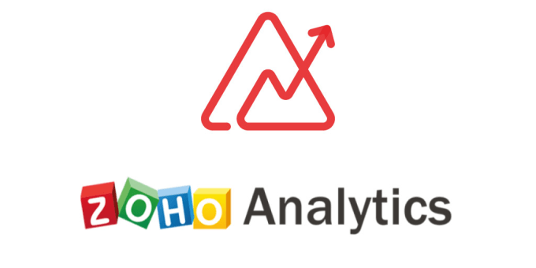
Auto-managed closed tools
Programming Languages
Notes:
We’ve broken this down into 2 main categories: “auto managed tools” are closed products. Tools that you can buy and start using right out of the box. Excel is a good example. Tableau and Looker are probably the most popular ones for Data Analysis.
In the other extreme, we have what we call “programming languages”, or we could call them “open tools”. These are not sold by any individual vendor, but they’re a combination of languages, open source libraries and products. Python, R and Julia are the most popular ones in this category.
Let’s explore the advantages and disadvantages of them.

Slide 11






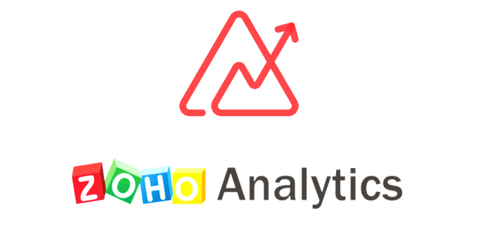
Auto-managed closed tools
Programming Languages
👎 Closed Source 🙅‍♂️
👎 Expensive 💸
👎 Limited 😩
👍 Easy to learn 👩‍💻
👍 Open Source 🤩
👍 Free (or very cheap) 🤑
👎 Extremely Powerful 💪
👎 Steep learning curve 👩‍💻
Notes:
The main advantage of closed tools like Tableau or Excel is that they’re generally easy to learn. There’s a company writing documentation, providing support and driving the creation of the product. The biggest disadvantage is that the scope of the tool is limited, you can’t cross the boundaries of it.
In contrast, using Python and the universe of PyData tools, gives you amazing flexibility. Do you need to read data from a closed API using secret key authentication? You can do it. Do you need to consume data directly from AWS Kinesis? You can do it. A programming language is the most powerful tool you can learn. Another important advantage is the general scope of a programming language. What happens if Tableau, for example, goes out of business? Or if you just get bored from it and feel like your career is stuck? Learning how to process data using a programming language gives you freedom.
The main disadvantage of a programming language is that it’s not as simple to learn as with a tool. You need to learn the basics of coding first, and it takes time.

Slide 12
Why Python
for Data Analysis?
Notes:
Why are we choosing Python to do Data Analysis?

Slide 13

Why Python for Data Analysis?
Why would we choose Python over R or Julia?
👍 very simple and intuitive to learn
👍 “correct” language
👍 powerful libraries (not just for Data Analysis)
👍 free and open source
👍 amazing community, docs and conferences
Notes:
Python is the best programming language to learn to code. It’s simple, intuitive and readable. It includes thousands of libraries to do virtually anything, from cryptography to IoT.
Python is free and open source. That means that there are thousands of eyes, very smart people seeing the internals of the language and the libraries. From Google to Bank of America, major institutions rely on Python everyday, which means that it’s very hard for it just to go away.
Finally, Python has a great open source spirit. The community is amazing. The documentation is exhaustive and there are a lot of free tutorials around. Check out for conferences in your area, it’s very likely that there’s a local group of python developers in your city.

Slide 14
When to choose R?
Python, sadly, is not always the answer
When R Studio is needed
When dealing with advanced statistical methods
When extreme performance is needed
Notes:
We couldn’t be talking about Data Analysis without mentioning R. R is also a great programming language. We prefer Python because it’s easier to get started, and more “general” in the libraries and tools it includes. R has an huge library of statistical functions, and if you’re in a highly technical discipline, you should check it out.

Slide 15
The Data Analysis
Process
Notes:
Let’s quickly review the Data Analysis process.

Slide 16
Data Extraction
Data Cleaning
Data Wrangling
Analysis
Action
SQL
Scrapping
File Formats
CSV
JSON
XML
Consulting APIs
Buying Data
Distributed Databases
Missing values and empty data
Data imputation
Incorrect types
Incorrect or invalid values
Outliers and non relevant data
Statistical sanitization
Hierarchical Data
Handling categorical data
Reshaping and transforming structures
Indexing data for quick access
Merging, combining and joining data
Exploration
Building statistical models
Visualization and representations
Correlation vs Causation analysis
Hypothesis testing
Statistical analysis
Reporting
Building Machine Learning Models
Feature Engineering
Moving ML into production
Building ETL pipelines
Live dashboard and reporting
Decision making and real-life tests
Notes:
The process starts by getting the data. Where is your data coming from? Usually, it’s in your own database. But it could also come from files stored in different formats or web APIs.
Once we’ve collected the data we’ll need to clean it. If the source of the data is your own database, then it’s probably already in shape. If you’re using more extreme sources, like web scraping, then the process will be more tedious.
With our data cleaned, we’ll now need to rearrange and reshape the data for better analysis. Transforming fields, merging tables, combining data from multiple sources, etc. The objective of this process is to get the data ready for the next step.
The process of analysis involves extracting patterns from the data that is now clean and in shape. Capturing trends or anomalies. Statistical analysis will be fundamental in this process.
Finally, it’s time to do something with that analysis. If this was a Data Science project, we could be ready to implement Machine Learning models. If we focus strictly on Data Analysis, we’ll probably need to build reports, communicate our results and support decision making.
Let me finish by saying that, in real life, this process isn’t so linear. We’re usually jumping back and forth between the steps, and it looks more like a cycle than a straight line.

Slide 17

Data Analysis
Vs
Data Science
Notes:
What’s the difference between Data Analysis and Data Science?

Slide 18
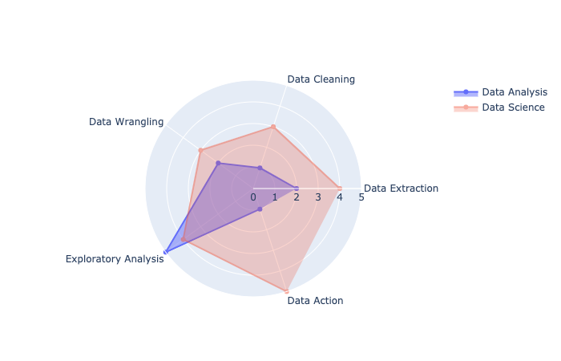
DATA ANALYSIS VS DATA SCIENCE
The traditional view
Notes:
The boundaries between Data Analysis and Data Science are not very clear. The main differences are that Data Scientists usually have more programming and math skills. They can then apply these skills in Machine Learning and ETL processes.
Data Analysts, on the other hand, have better communication skills, creating better reports, with stronger storytelling abilities.
Source: https://notebooks.ai/santiagobasulto/radar-chart-data-science-vs-data-analysis-ad638c75

Slide 19
Data Analysis Vs Data Science
For Data Cleaning, Scores high as it heavily relies on data cleaning to ensure accurate results.
For data action, Scores moderate as it focuses on generating actionable insights.
For Data Wrangling, Scores moderately as it involves formatting and structuring data for immediate analysis.
Data Extraction, Scores lower because it often works with pre-extracted datasets.
For Data Cleaning, Also scores high but slightly less because its emphasis shifts towards preparing data for advanced modeling.
For Data action,Scores moderate as it focuses on generating actionable insights.
For Data Wrangling, Scores higher due to the broader scope of handling complex and diverse data sets
For Data Extraction, Scores higher as it involves extracting data from various sources, often requiring programming and automation.

Slide 20
Python & PyData Ecosystem
Notes:
Let’s explore the Python and PyData ecosystem. All the tools and libraries that we’ll be using.

Slide 21
PYTHON ECOSYSTEM:
The libraries we use...
pandas: The cornerstone of our Data Analysis job with Python
matplotlib: The foundational library for visualizations. Other libraries we’ll use will be built on top of matplotlib.
numpy: The numeric library that serves as the foundation of all calculations in Python.
seaborn: A statistical visualization tool built on top of matplotlib.
statsmodels: A library with many advanced statistical functions.
scipy: Advanced scientific computing, including functions for optimization, linear algebra, image processing and much more.
scikit-learn: The most popular machine learning library for Python (not deep learning)
Notes:
The most important libraries we’ll be using are Pandas for Data Analysis, and Matplotlib and Seaborn for visualizations. But the ecosystem is large, and there are many useful libraries for specific use cases.

Slide 22
How Python Data
Analysts Think
Notes:
How Python Data Analysts think?

Slide 23
EXCEL, TABLEAU, ETC.
They’re all visual tools...
Notes:
If you’re coming from a traditional Data Analysis place using tools like Excel and tableau, you’re probably used to have a constant visual reference of your data. All the tools are “point and click”. This works great for small amount of data, but it’s less useful when the amount of records grow. It’s just impossible for humans to visually reference too much data, and the processing gets incredibly slow.

Slide 24

Thinking like a
Python Data Analyst
Notes:
In contrast, when we work with Python, we don’t have a constant visual reference of the data we’re working with. We know it’s there, we know how it looks like, we know the main statistical properties of it, but we’re not constantly looking at it. This allows us to work with millions of records incredibly fast. This also means you can move your Data Analysis processes to other computers, for example in the cloud, without much overhead.

Slide 25
And finally,
why Python?
Notes:
And finally, why would you like to add Python to your Data Analysis skills.
Aside from the advantages of freedom and power, there’s an important reason:

Slide 26
About this tutorial
What is Data Analysis
Real Example Data Analysis with Python
How to use Jupyter Notebooks
Intro to NumPy
Intro to Pandas
Data Cleaning
Reading Data SQL, CSVs, APIs, etc
Python in Under 30 Minutes
Notes:
So, that’s it! Let’s get started! In our following section, we’ll show you a Real World example of Data Analysis with Python. We want you to see, right away, what you’ll be able to do AFTER this tutorial.

